Slide 1

STATISTICS
Kendall's tau
Partial Correlation
Scatter Plot

Slide 2
What is Kendall's tau?
Kendall’s tau is a nonparametric analogue to the Pearson product moment correlation.
Similar to spearman’s Rho, Kendall’s Tau operates on rank-ordered(ordinal) data but is particularly useful when there are tied ranks.

Slide 3
Kendall's tau coefficient
In statistics, the Kendall rank correlation coefficient, commonly referred to as Kendall's tau coefficient (after the Greek letter τ ), Is a statistic used to measure the ordinal association between two measured quantities.
Kendall’s Tau has usually smaller values than Spearman’s rho correlation.
Calculation is based on concordant and discordant pairs.
Insensitive to error.
P values are more accurate with smaller sample sizes.

Slide 4
What is Kendall used for?
The Kendall rank coefficient is often used as a test statistic in a statistical hypothesis test to establish whether two variables may be regarded as statistically dependent.
This test is non-parametric, as it does not rely on any assumptions on the distributions of X or Y or the distribution of (X,Y).

Slide 5
Advantage of Kendall’s tau
The main advantages of using Kendall’s tau are as follows:
The distribution of Kendall’s tau has better statistical properties.
The interpretation of Kendall’s tau in terms of the probabilities of observing the agreeable (concordant) and non-agreeable (discordant) pairs is very direct.
In most of the situations, the interpretations of Kendall’s tau and Spearman’s rank correlation coefficient are very similar and thus invariably lead to the same inferences.

Slide 6
Example problem
Two professors ranked 12 students (A through L) for a position. The results from most preferred to least preferred are:
Professor 1: ABCDEFGHIJKL
Professor 2: ABDCFEHGJILKL
Calculate the Kendall Tau correlation.
Soln:
The rankings for professor 1 should be in ascending order (from least to greatest)

Slide 7
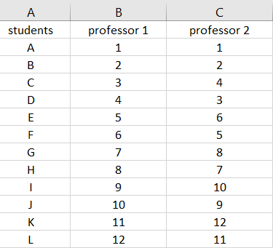
using the second column. Concordant pairs are how many larger ranks are below a certain rank. For example, the first rank in the second professor column is a “1”, so all 11 ranks below it are larger.

Slide 8
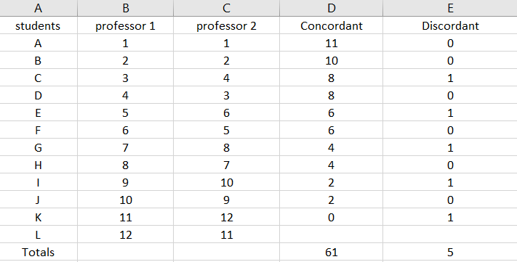
Insert the totals into the formula:
Kendall’s Tau = (C - D / C + D )
= (61 – 5) / (61 + 5)
=56 / 66
= .85
The Tau coefficient is .85, suggesting a strong relationship between the rankings

Slide 9


Calculating Statistical Significance:
If you want to calculate statistical significance for your result , use this formula to get a z-value.
= 3*.85*11.489 / 7.616
= 3.85
Finding the area for a z-score of 3.85 on a z-table gives an area of .0001 a tiny probability value which tells you this result is statistically significant.

Slide 10
Partial Correlation
Special form of correlation between two variables.
Part of multivariate statistics involving more than two variables in a sample.
Partial correlations explain how variables work together to explain patterns in the data.
In partial correlation variables will be often work together to explain patterns in data.

Slide 11
Partial Correlation
Partial correlations can be used in many cases that assess for relationship, like whether or not the sale value of a particular commodity is related to the expenditure on advertising when the effect of price is controlled.

Slide 12
Hypothesis For Partial Correlation
Null hypothesis: There is no partial correlation between variables
Alternate Hypothesis: There is partial correlation between variables

Slide 13

Formula For Partial Correlation
The first order partial correlation is used to define the process.
The formula for computing partial correlation is

Slide 14
Scatter Plot
A scatterplot is a graphical way to display the relationship between two quantitative sample variables.
It represents data points on a two-dimensional plane or on a Cartesian system .
The variable or attribute which is independent is plotted on the X-axis, while the dependent variable is plotted on the Y-axis.
The line will be drawn in a scatter plot, all the points in the plot is known as “ line of best fit ” or “ trend line “.

Slide 15
Why we Use Scatter Plot?
To find outlier
When we have a pair of numeric data
Correlation
Identify the type of relationship between two quantities.

Slide 16
How many variables are used in scatter plot?
Most scatter plots will have 2 variables that are used as the 2 axes.
The independent variable is the variable that you will be manipulating and changing.
The dependent variable is the variable that is changed by the independent variable.

Slide 17
